Slide 1
OPENSHIFT
Jim Garrett
Senior Solution Architect
jgarrett@redhat.com

Slide 2
Agenda
Container Discussion
See how Red Hat OpenShift Container Platform makes it easy to build containers from source code
Deploy sample applications on Red Hat OpenShift Container Platform

Slide 3
Introductions
Name
Role/Title
Experience/knowledge with Containers?

Slide 4
Goal – Answer These Questions
What is the problem?
Who are the characters?
How do you solve the problem?
What happens at the end, what do you get out of it?

Slide 5


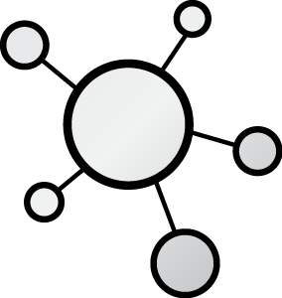



THE CHARACTERS
DEVELOPERS
Notes:
Developers have different motivations and concerns than the IT Operations.
Developer's job is to deliver a code
IT Operations’ job is to bring stability
Environment predictability
As a result, applications are designed and developed in accordance to Developers mindset and Operations requirements are layered over it at later stages of delivery, leading to frustrating frictions specially in the end of each delivery cycle.

Slide 6

Historical Development
Notes:
In the historical Software Development model most requirements start with the Business Analyst.
The Business Analyst is someone who pulls together all the data (research, analysis, rules, business process, etc) about a story at a high level and then interpret or translate that story into easy to understand document that the software development team can read and gain understanding into what they’re being asked to create.
The Business Analyst accumulates the data and creates the Requirements Document for the software and then gives the document to the Lead Architect of the Development Team.
The Lead Architect’s role is to review the Requirements and develop an appropriate architecture to support the requirements.
Typically, the Lead Architect will escape to his favorite quiet place where he will then pull from his vast bag of resources to then define the internal components that will be used to construct the application that meets the Business Analyst requirements.
The architecture would include all tools and software libraries needed to create the Enterprise Architecture.

Slide 7

Historical Development
Lead Architect
Notes:
In the historical Software Development model most requirements start with the Business Analyst.
The Business Analyst is someone who pulls together all the data (research, analysis, rules, business process, etc) about a story at a high level and then interpret or translate that story into easy to understand document that the software development team can read and gain understanding into what they’re being asked to create.
The Business Analyst accumulates the data and creates the Requirements Document for the software and then gives the document to the Lead Architect of the Development Team.
The Lead Architect’s role is to review the Requirements and develop an appropriate architecture to support the requirements.
Typically, the Lead Architect will escape to his favorite quiet place where he will then pull from his vast bag of resources to then define the internal components that will be used to construct the application that meets the Business Analyst requirements.
The architecture would include all tools and software libraries needed to create the Enterprise Architecture.

Slide 8

Historical Development
Notes:
In the historical Software Development model most requirements start with the Business Analyst.
The Business Analyst is someone who pulls together all the data (research, analysis, rules, business process, etc) about a story at a high level and then interpret or translate that story into easy to understand document that the software development team can read and gain understanding into what they’re being asked to create.
The Business Analyst accumulates the data and creates the Requirements Document for the software and then gives the document to the Lead Architect of the Development Team.
The Lead Architect’s role is to review the Requirements and develop an appropriate architecture to support the requirements.
Typically, the Lead Architect will escape to his favorite quiet place where he will then pull from his vast bag of resources to then define the internal components that will be used to construct the application that meets the Business Analyst requirements.
The architecture would include all tools and software libraries needed to create the Enterprise Architecture.

Slide 9
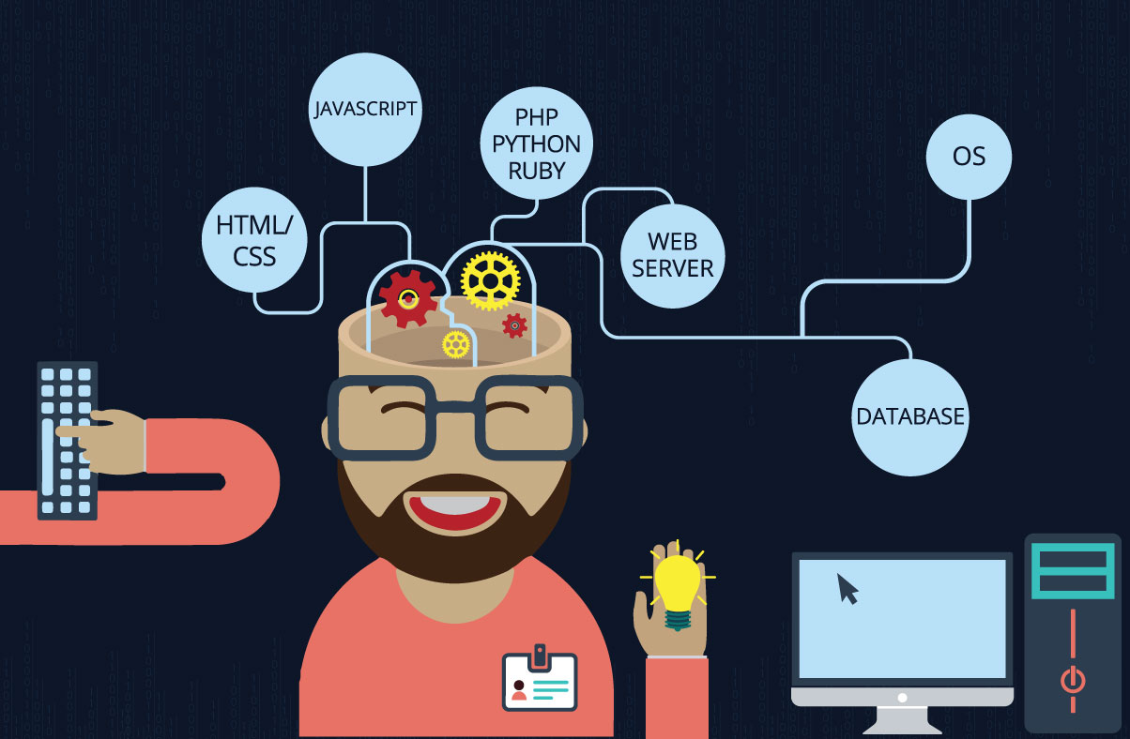
Historical Development
Notes:
In the historical Software Development model most requirements start with the Business Analyst.
The Business Analyst is someone who pulls together all the data (research, analysis, rules, business process, etc) about a story at a high level and then interpret or translate that story into easy to understand document that the software development team can read and gain understanding into what they’re being asked to create.
The Business Analyst accumulates the data and creates the Requirements Document for the software and then gives the document to the Lead Architect of the Development Team.
The Lead Architect’s role is to review the Requirements and develop an appropriate architecture to support the requirements.
Typically, the Lead Architect will escape to his favorite quiet place where he will then pull from his vast bag of resources to then define the internal components that will be used to construct the application that meets the Business Analyst requirements.
The architecture would include all tools and software libraries needed to create the Enterprise Architecture.

Slide 10
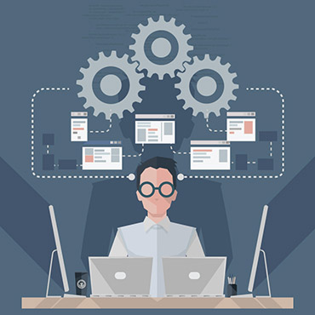
Historical Development
Notes:
The Enterprise Architect would then establish his own local development environment where all the independent development libraries are assembled and tested.
He then needs to make sure his Enterprise Architecture is well understood and that other team members can reproduce his environment.
To do this, he creates a Software Architecture Document that can be given to members as they join the team.
The new team members would then use this document to replicate the Architecture on their local machines.

Slide 11
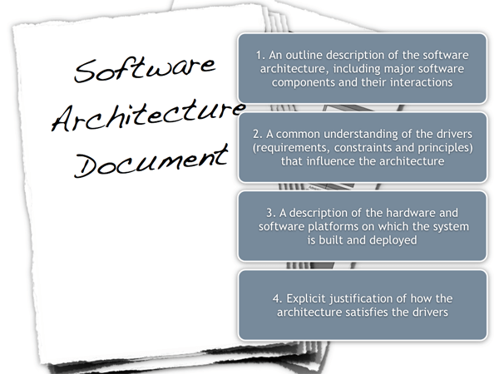
Historical Development
Notes:
The Enterprise Architect would then establish his own local development environment where all the independent development libraries are assembled and tested.
He then needs to make sure his Enterprise Architecture is well understood and that other team members can reproduce his environment.
To do this, he creates a Software Architecture Document that can be given to members as they join the team.
The new team members would then use this document to replicate the Architecture on their local machines.

Slide 12

Historical Development
Notes:
The Enterprise Architect would then establish his own local development environment where all the independent development libraries are assembled and tested.
He then needs to make sure his Enterprise Architecture is well understood and that other team members can reproduce his environment.
To do this, he creates a Software Architecture Document that can be given to members as they join the team.
The new team members would then use this document to replicate the Architecture on their local machines.

Slide 13


Historical Development Challenges
How do you Synchronize???

Slide 14
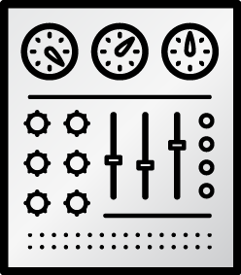

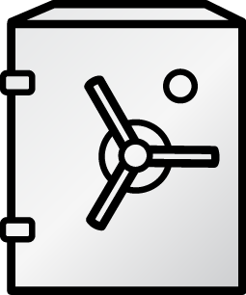




THE CHARACTERS
DEVELOPERS
I.T. OPERATIONS
Notes:
Developers have different motivations and concerns than the IT Operations.
Developer's job is to deliver a code
IT Operations’ job is to bring stability
Environment predictability
As a result, applications are designed and developed in accordance to Developers mindset and Operations requirements are layered over it at later stages of delivery, leading to frustrating frictions specially in the end of each delivery cycle.

Slide 15
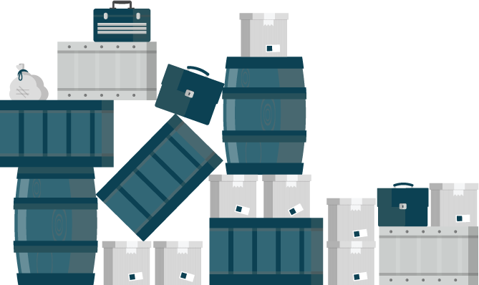
The Problem
Applications require complicated installation and integration every time they are deployed
Lots of Friction
Leads to poor quality of delivered service
Larger Deployments
Avoid pain by deploying less often
Notes:
Delivering an application into production is a non-trivial task
lots of friction and many back-and-forth cycles between Developers and IT Operations.
Painful deployments leads poor quality of the delivered service
Tendency to avoid the pain by deploying to production as seldom as possible.
Results in larger deployments with more features being delivered at once and higher risk of things going wrong, which results in more pain, fewer deployments, … and story goes on.

Slide 16
Top 10 Replies by Programmers
IT WORKS ON MY MACHINE!!!
Where were you when the program blew up?
Why do you want to do it that way?
You can’t use that version on your system!
Somebody must have changed my code!
It works but it hasn’t been tested.
I can’t test everything!
You must have the wrong version!!!
It’s never done that before!
That’s weird!

Slide 17
DEVOPS - Setting
Everything as code
Application monitoring
Automate everything
Rapid feedback
Continuous Integration/Delivery
Rebuild vs. Repair
Application is always “releaseable”
Delivery pipeline
Notes:
DevOps has Gained popularity in the last two years.
Many of the practices and values in DevOps aim at mitigating this problem described previously.
However implementing these practices proved to be extremely difficult using virtualization and other technologies which were available at the time.

Slide 18
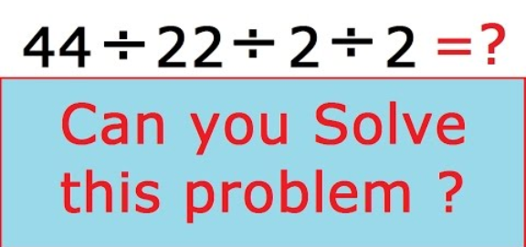

Slide 19
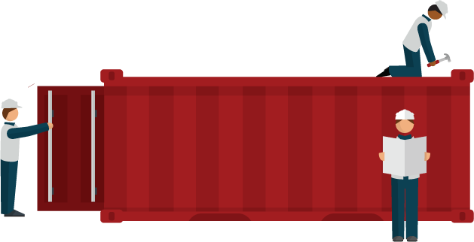
The Solution
Adopt a container strategy
Allows applications to be easily shared and deployed.
Simplifies the automation that DevOps provides
Provide consistent environment for Developers and Operations
Write once – deploy anywhere
Notes:
DevOps only took off when containers gained popularity
Simplifies the automation that DevOps provides.
Containers provide consistent environment and tools for both Developers and Operations
Simplify the deployment process regardless of what the application looks like
Recreate identical environments for development, testing, staging, and production
Write once; deploy anywhere

Slide 20
TRADITIONAL OS VS. CONTAINERS
Traditional OS
Containers
CONTAINER
CONTAINER
APP A
APP B
APP A
APP B
HOST OS
LIBS A
LIBS B
LIBS C
LIBS D
LIBS A
LIBS B
LIBS C
LIBS D
HOST OS
INFRASTRUCTURE
INFRASTRUCTURE
Notes:
Full Stack software packaging concept that typically includes a Single Application and all of its runtime dependencies
Easy to deploy and portable across host systems, eliminating differences between different application life-cycle stage deployments
Isolates applications on a host operating system
Encourages Microservices

Slide 21
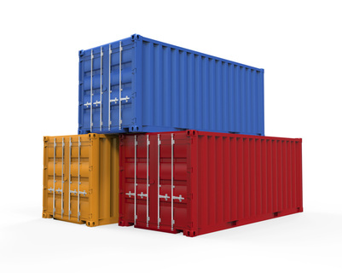
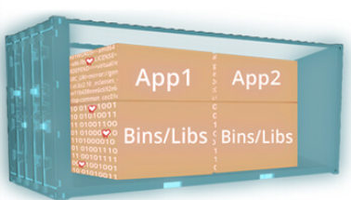

Slide 22

WHAT ARE CONTAINERS? It Depends Who You Ask
INFRASTRUCTURE
APPLICATIONS
Sandboxed application processes that run on a shared Linux OS kernel
SE Linux
Simpler, lighter, and denser than virtual machines
Portable across different environments
Package the application and all of its dependencies
Deploy to any environment in seconds and enable CI/CD
Easily access and share containerized components
Notes:
Infrastructure perspective
containers rely on Linux operating system features
isolate slices of the underlying operating system.
Has some libraries from Linux operating system inside it.
Consume less resources compared to virtual machines.
Pose complexities that need orchestration and management to be used effectively.
Application perspective
way to package an enterprise application in a self-contained artifact.
Simple to share those apps across the organization.
Developers have full control over the content of a container

Slide 23
THE SOLUTION
Container
App
Controlled by Developers
Operating System
Controlled by IT Operations
Virtual Machine
Hardware
Notes:
IT Operations controls
hardware, virtualization layer, operating system and make sure they are patched, secure and managed in accordance to their best practises.
know how to run containers effectively on top of that infrastructure to maximise utilisation.
Developers
control the application, frameworks and libraries used in the application and package that as a container which is delivered to IT Operations.
mitigates the traditional friction between the two teams in the software delivery process.

Slide 24


THE SOLUTION
DEVELOPERS
I.T. OPERATIONS
Notes:
The promise of containers is that everybody’s needs are fulfilled
teams can work together in better ways than previously they were able to.
In the eyes of many inside the organization, containers come to the rescue as the common language between Developers and IT Operations.
Containers can drive a revolutionary change into how these two sides of an IT organization work together;
allow developers and the line of business to own their applications in the form of containers that then can be deployed, maintained, and operated on top of infrastructure that the Ops team provides, without compromising security or compliance.

Slide 25
WE NEED MORE THAN JUST CONTAINERS
WE NEED ORCHESTRATION!!!
Scheduling Decide where to deploy containers
Security Control who can do what
Lifecycle and health Keep containers running despite failures
Scaling
Scale containers up and down
Discovery Find other containers on the network
Persistence
Survive data beyond container lifecycle
Monitoring Visibility into running containers
Aggregation
Compose apps from multiple containers
Notes:
Although building and running single containers on a host is fairly simple, build and running multi-container application across multiple infrastructure requires more than just containers.

Slide 26
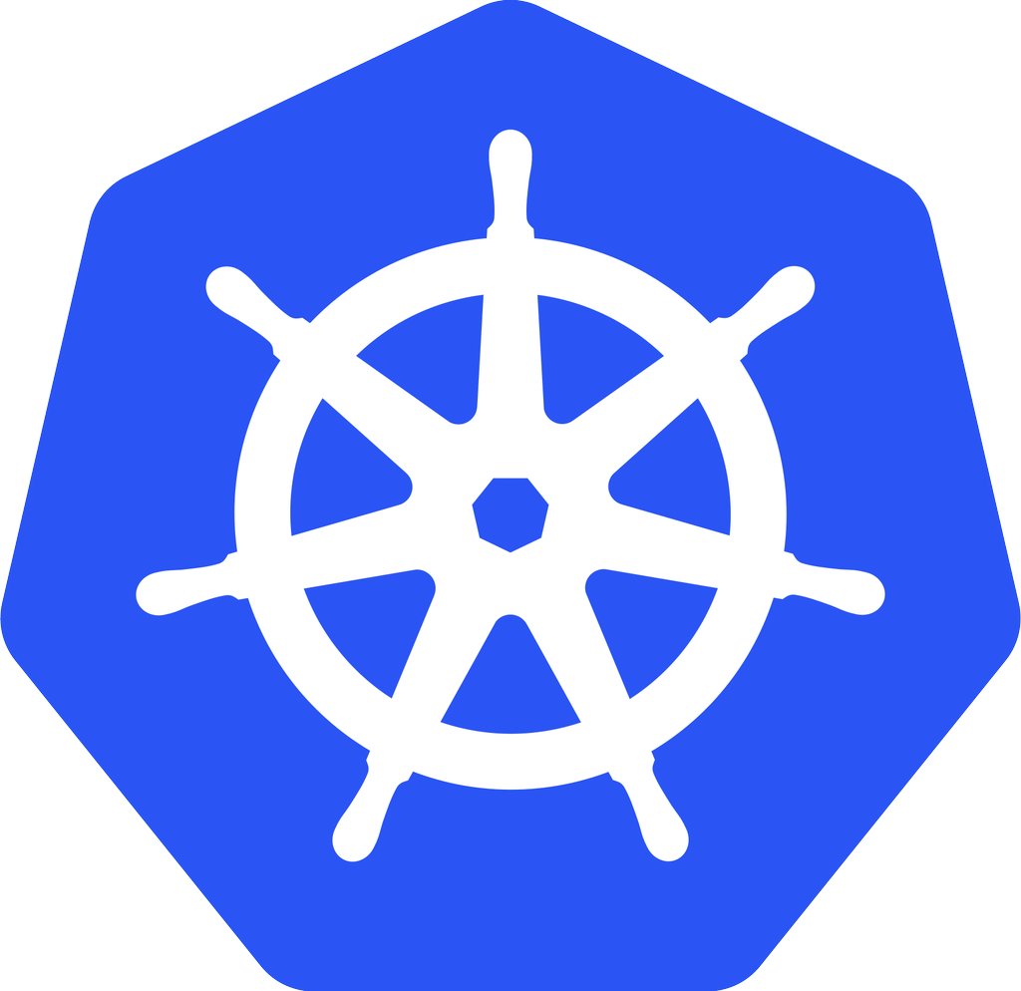
Kubernetes
- Developed by Google
- A collection of API’s for managing container based
workloads
- open-source ORCHESTRATION framework
Manages container lifecycle, health, scaling
Red Hat is THE top contributor to Kubernetes, after Google
kubernetes
Notes:
Kubernetes automates deployments of containers across the hosts
Kubernetes
open-source orchestration framework
developed by Google
manage the containers lifecycle, health, scaling, authentication, discovery and persistence.
15+ years of experience
Red Hat along with Google is the top contributor to the Kubernetes project.

Slide 27
BUT WAIT, THERE’S MORE!
Multi-tenancy
Teams and Collaboration
Routing & Load Balancing
Quota Management
CI/CD Pipelines
Image Build Automation
Role-based Authorization
Container Isolation
Capacity Management
Vulnerability Scanning
Infrastructure Visibility
Chargeback
Notes:
Even that still is not enough. There are more capabilities needed to successfully taking these containers to production.

Slide 28

CRI-O (Container Runtime Interface – Open Container Initiative)
Leading enterprise distribution of Kubernetes
Building, Distributing and Running containers at scale
Rapid Application
Deployment
Scaling
Notes:
OpenShift is Red Hat’s container platform based on docker and Kubernetes that brings in all the pieces together
leading enterprise distribution of Kubernetes
optimized for continuous application development and multi-tenant deployment.
adds developer and operational centric tools to enable rapid application development
Provides easy deployment and scaling
Red Hat is a leading contributor to the docker and Kubernetes projects.

Slide 29
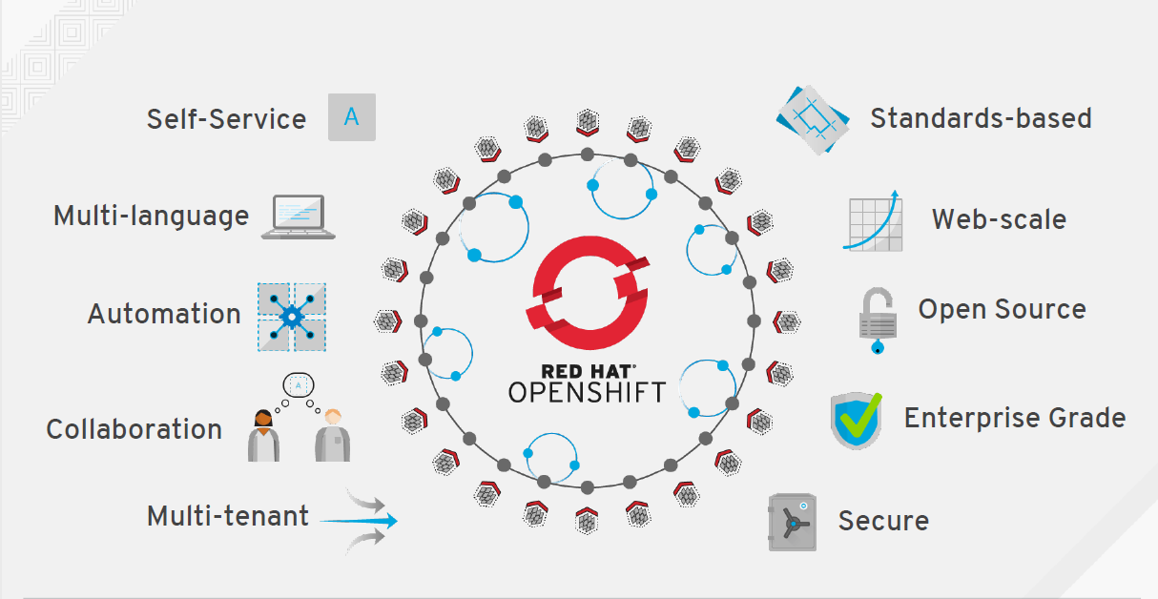

Slide 30

ARCHITECTURE

Slide 31


OpenShift runs on your choice of infrastructure
Notes:
Speaker:
* From bare metal physical machines to virtualized infrastructure, or in private or certified public clouds, OpenShift is supported anywhere that Red Hat Enterprise Linux is.
* This includes all the supported virtualization platforms - RHEV, vSphere or Hyper-V.
* Red Hat’s OpenStack platform and certified public cloud providers like Amazon, Google and more are supported, too.
* You can even take a hybrid approach and deploy instances of OpenShift Enterprise across all of these infrastructures.
Discussion:
* Show the flexibility of deploying OpenShift
* Technically only x86 platforms are supported.
Transcript:
OpenShift is fully supported anywhere Red Hat Enterprise Linux is. Hybrid deployments across multiple infrastructures can be achieved, but many customers are still adopting OpenShift inside their existing, traditional virtualized environments.

Slide 32

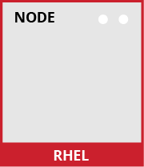
Nodes are instances of RHEL where apps will run
Notes:
Speaker:
* OpenShift has two types of systems. The first are called nodes.
* Nodes are instances of RHEL 7 or RHEL Atomic with the OpenShift software installed.
* Ultimately, Nodes are where end-user applications are run.
Discussion:
* The Nodes are what the Masters will orchestrate - you will learn about Masters shortly.
* Nodes are just instances of RHEL or Atomic.
* OpenShift’s node daemon and other software runs on a node.
Transcript:
OpenShift can run on either RHEL or RHEL Atomic. Nodes are just instances of RHEL or Atomic that will ultimately host application instances in containers.

Slide 33
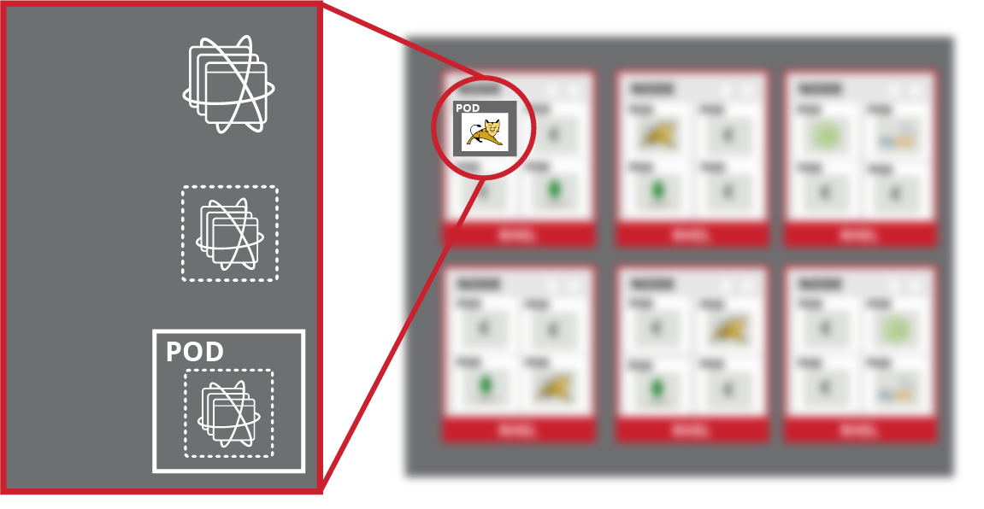
Apps and components run in containers
Container Image
Container
Pod
Notes:
Speaker:
* Application instances and application components run in Docker containers
* Each OpenShift Node can run many containers
Discussion:
* A node’s capacity is related to the memory and CPU capabilities of the underlying “hardware”
Transcript:
All of the end-user application instances and application components will run inside Docker containers on the nodes. RHEL instances with bigger CPU and memory footprints can run more applications.

Slide 34
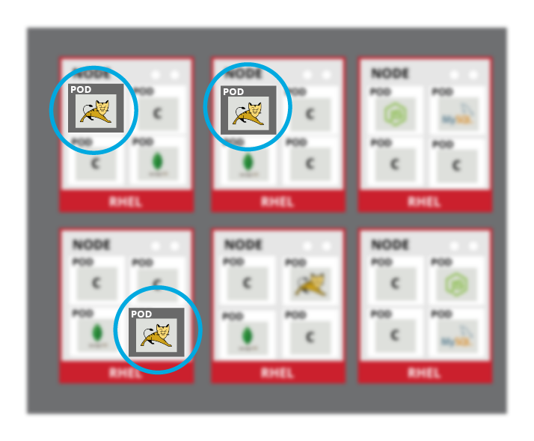
Pods are the orchestrated unit in OpenShift
Notes:
Speaker:
* While app components run in Docker containers, the “unit” that OpenShift is orchestrating and managing is called a Pod
* In this case, a Docker image is the executable or runnable components, and the container is the actual running instance with runtime and environment parameters
* One or more containers make up a Pod, and OpenShift will schedule and run all containers in a Pod together
* Complex applications are made up of many Pods each with their own containers, all interacting with one another inside an OpenShift environment
Discussion:
* OpenShift consumes Docker Images and runs them in containers wrapped by the meta object called a Pod.
* The Pod is what OpenShift schedules, manages and runs.
* Pods can have multiple containers but there are not many well-defined use cases
* Services, described soon, are how different application components are “wired” together. Different application components (eg: app server, db) are not placed in a single Pod
Transcript:
OpenShift can use any native Docker image, and schedules and runs containers in a unit called a Pod. While Pods can have multiple containers, generally a Pod should provide a single function, like an app server, as opposed to multiple functions, like a database and an app server. This allows for individual application components to be easily scaled horizontally.

Slide 35
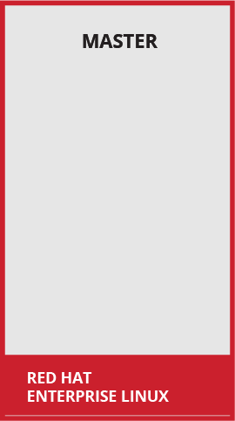
Masters are the Control Plane
Notes:
Speaker:
* The other type of OpenShift system is the Master
* Masters keep and understand the state of the environment and orchestrate all activities on the Nodes
* Masters are also instances of RHEL or Atomic, and multiple masters can be used in an environment for high availability
* Masters have four primary jobs or functions
Discussion:
* The OpenShift Master is the orchestrator of the entire OpenShift environment.
* The OpenShift Master knows about and maintains state within the OpenShift environment.
* Just like Nodes, Masters run on RHEL or Atomic
* You will discuss the four primary functions of the Master in the next slides
Transcript:
Just like Nodes, the OpenShift Master is installed on RHEL or Atomic. The Master is the orchestration and scheduling engine for OpenShift, and is responsible for knowing and maintaining the state of the OpenShift environment. The Master has four primary functions which you will now describe.

Slide 36

API and Authentication
Notes:
Speaker:
* The Master provides the single API that all tooling and systems interact with. Everything must go through this API.
* All API requests are SSL-encrypted and authenticated. Authorizations are handled via fine-grained role-based access control (RBAC)
* The Master can be tied into external identity management systems, from LDAP and AD to OAuth providers like GitHub and Google
Discussion:
* All requests go through the Master’s API
* The Master evaluates requests for both AuthentacioN (AuthN - you are who you say you are) and AuthoriZation (AuthZ - you’re allowed to do what you requested)
* The Master can be tied into external identity management systems like LDAP/AD, OAuth, and more
* Apache modules can also be used for authentication in front of the API
Transcript:
The Master is the gateway to the OpenShift environment. All requests must go through the Master and must be both authenticated and authorized. A wide array of external identity management systems can be the source of authentication information in an OpenShift environment.

Slide 37

Desired and Current State
Notes:
Speaker:
* The desired and current state of the OpenShift environment is held in the data store
* The data store uses etcd, a distributed key-value store
* Other things like the RBAC rules, application environment information, and non-application-user-data are kept in the data store
Discussion:
* etcd holds information about the desired and current state of OpenShift
* Additionally, user account info, RBAC rules, environment variables, secrets, and many other bits of OpenShift information are held in the data store
* More generally, any OpenShift data object is stored in etcd
Transcript:
Etcd is another of the critical components of the OpenShift architecture. It is the distributed key-value data store for state and other information within the OpenShift environment. Reads and writes of information generally are going to hit the data store.

Slide 38


Scheduler Pulls From The Registry
Notes:
Speaker:
* The scheduler portion of the Master is the specific component that is responsible for determining Pod placement
* The scheduler takes the current memory, CPU and other environment utilization into account when placing Pods on the various nodes
Discussion:
* The scheduler is responsible for Pod placement
* Current CPU, Memory and other environment utilization is considered during the scheduling process
Transcript:
The OpenShift scheduler uses a combination of configuration and environment state to determine the best fit for running Pods across the Nodes in the environment.

Slide 39



Orchestration and Scheduling
Notes:
Speaker:
* The scheduler portion of the Master is the specific component that is responsible for determining Pod placement
* The scheduler takes the current memory, CPU and other environment utilization into account when placing Pods on the various nodes
Discussion:
* The scheduler is responsible for Pod placement
* Current CPU, Memory and other environment utilization is considered during the scheduling process
Transcript:
The OpenShift scheduler uses a combination of configuration and environment state to determine the best fit for running Pods across the Nodes in the environment.

Slide 40
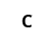


Placement by Policy
Notes:
Speaker:
* The real-world topology of the OpenShift deployment (regions, zones, and etc) is used to inform the configuration of the scheduler
* Administrators can configure complex scenarios for scheduling workloads
Discussion:
* The scheduler is configured with a simple JSON file in combination with node labels to carve up the OpenShift environment to make it look like the real world topology
Transcript:
The topology of the real-world environment is used by platform administrators to determine how to configure the scheduler and the Node labels.

Slide 41





Services connect application components
Notes:
Speaker:
* OpenShift’s service layer enables application components to easily communicate with one another
* The service layer provides for internal load balancing as well as discovery and code reusability
Discussion:
* The service layer is used to connect application components together
* OpenShift automatically injects some service information into running containers to provide for ease of discovery
* Services provide for simple internal load balancing across application components
Transcript:
OpenShift’s service layer is how application components communicate with one another. A front-end web service would connect to database instances by communicating with the database service. OpenShift would automatically handle load balancing across the database instances. Service information is injected into running containers and provides for ease of application

Slide 42

Health and Scaling
Notes:
Speaker:
* The Master is responsible for monitoring the health of Pods, and for automatically scaling them as desired
* Users configure Pod probes for liveness and readiness
* Currently pods may be automatically scaled based on CPU utilization
Discussion:
* The Master handles checking the health of pods by executing the defined liveness and readiness probes
* Probes can be easily defined by users
* Autoscaling is available today against CPU only
* The next slides will depict a health event for you to describe
Transcript:
The OpenShift Master is capable of monitoring application health via user-defined Pod probes. The Master is also capable of scaling out Pods based on CPU utilization metrics.

Slide 43

What about unhealthy Pods?
Notes:
Speaker:
* What happens when the Master sees that a Pod is failing its probes?
* What happens if containers inside the Pod exited because of a crash or other issue?
Discussion:
* Here you are describing the beginning of how the Master detects failures and remediates them
Transcript:
This first slide allows you to ask the question “What happens when…?”. The next slide will describe the remediation process for failed Pods.

Slide 44
The Master remediates Pod failures
Notes:
Speaker:
* The Master will automatically restart Pods that have failed probes or possibly exited due to container crashes.
* Pods that fail too often are marked as bad and are temporarily not restarted.
* OpenShift’s service layer makes sure that it only sends traffic to healthy Pods, maintaining component availability -- all orchestrated by the Master automatically.
Discussion:
* The Master will restart Pods that are determined to be failing, for whatever reason.
* The Service layer is automatically updated with only healthy Pods as endpoints.
* All of this is done automatically.
* Pods that continually fail are not restarted for a while. This is a “crash loop back-off”.
Transcript:
The OpenShift Master is capable of remediating Pod failures automatically. It manages the traffic through the Service layer to ensure application availability and handles restarting Pods, all automatically and without any user intervention.

Slide 45
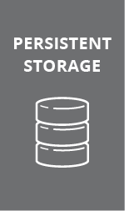
What about app data?
Notes:
Speaker:
* Applications are only as useful as the data they can manipulate.
* Docker containers are natively ephemeral - data is not saved when containers are restarted or created.
* OpenShift provides a persistent storage subsystem that will automatically connect real-world storage to the right Pods, allowing for stateful applications to be used on the platform.
* A wide array of persistent storage types are usable, from raw devices (iSCSI, FC) to enterprise storage (NFS) to cloud-type options (Gluster/Ceph, EBS, pDisk, etc)
Discussion:
* OpenShift’s persistent volume system automatically connects storage to Pods
* The persistent volume system allows stateful apps to be used on the platform
* OpenShift provides flexibility in the types of storage that Pods can consume
Transcript:
OpenShift’s persistent volume system allows end users to consume a wide array of storage types to enable stateful applications to be run on the platform. Whether OpenShift is running locally in the datacenter or in the cloud, there are storage options that can be used.

Slide 46

Routing layer for external accessibility
Notes:
Speaker:
* Not every consumer of applications exists inside the OpenShift platform. External clients need to be able to access things running inside OpenShift
* The routing layer is a close partner to the service layer, providing automated load balancing to Pods for external clients
* The routing layer is pluggable and extensible if a hardware or non-OpenShift software router is desired
Discussion:
* The OpenShift router runs in pods on the platform itself, but receives traffic from the outside world and proxies it to the right pods
* The router uses the service endpoint information to determine where to load balance traffic, but it does not send traffic through the service layer
* The router is built with HAProxy, but is a pluggable solution. Red Hat currently supports F5 integration as another option.
Transcript:
OpenShift’s routing layer provides access for external clients to reach applications running on the platform. The routing layer runs in Pods inside OpenShift, and features similar load balancing and auto-routing around unhealthy Pods as the Service layer.

Slide 47

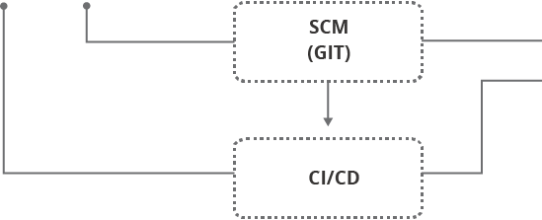
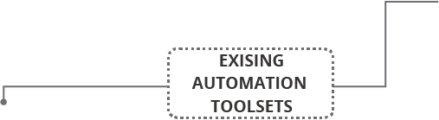

Access via Web UI, CLI, IDE, API
Notes:
Speaker:
* All users, either operators, developers, or application administrators, access OpenShift through the same standard interfaces
* Ultimately, the Web UI, CLI and IDEs all go through the authenticated and RBAC-controlled API
* Users do not need system-level access to any of the OpenShift hosts -- even for complicated debugging and troubleshooting.
* Continuous Integration (CI) and Continuous Deployment (CD) systems can be easily integrated with OpenShift through these interfaces, too.
* Operators and Administrators can utilize existing management and monitoring tooling in many ways.
Discussion:
* All interaction with the OpenShift environment and its tools goes through the API and is controlled by the defined RBAC settings.
* The tools and the API provide for ways to access application instances -- even for things like shells and terminals for debugging
* Existing RHEL management tooling and many existing monitoring suites can be integrated with OpenShift
* CI/CD solutions can be integrated with OpenShift to provide for complete automated lifecycle management.
Transcript:
Interacting with OpenShift boils down to interacting with the API, no matter what tools are being used. CI, CD, management, monitoring and other tooling can all go through the OpenShift API for automation purposes. And, since OpenShift is built on top of RHEL, existing systems management and systems monitoring tools can be used, too.

Slide 48
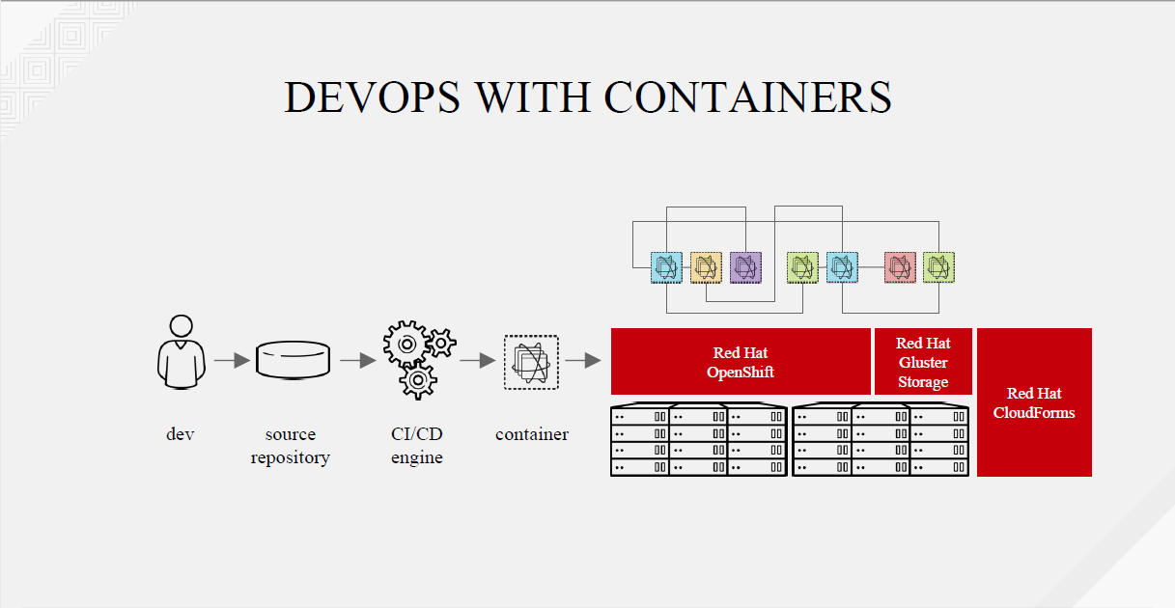

Slide 49
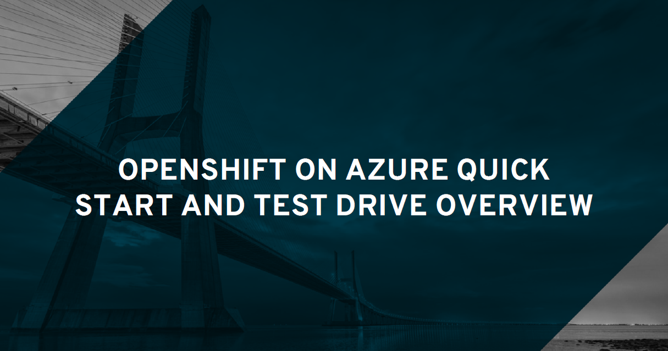

Slide 50
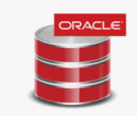
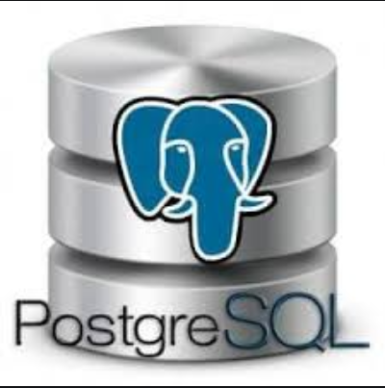
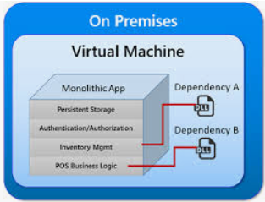
Are All Applications Good Candidates for Containerization?
Complicated installation procedures
Configuration Files
Remote Storage
Log Files
Session Management/Replication
High Availability – Clustering
Stateful Containers
Complexity Makes People Hesitant
SHORT ANSWER ----- NO!!!!
IT TAKES A VILLAGE!!!!
Notes:
One of the challenges with container based architectures is the fact that not all applications are good candidates for containerization. Why is that???
Many applications require complicated installation procedures which are not easily replicated. Classic examples are applications like PostgreSQL and Oracle. To correctly install and configure these applications requires someone who is a domain expert, someone like a Database Administrator. Even though just about anyone can install these tools, it requires an expert to do it correctly
When you think about todays Monolithic applications, they may have complicated installation procedures that involve Configuration Files, Remote Storage, Log file placement and other challenging installation steps. When talking about application servers you may need to have expertise with session management and replication or stateful containers.
The reality is that complexity makes people hesitant to take on this challenge with containerizing these application types.
What if there was a solution to this challenge. What if there was a way where someone could leverage subject matter experts to create the templates that would handle all the challenges with provisioning these kinds of containers.

Slide 51
Welcome to the World of Operators
Conceptually
Operators take human operational knowledge and encode it into software that is more easily shared with consumers.
Technically
Operators are a method of packaging, deploying, and managing a Kubernetes application.
Why use Operators?
Repeatability of installation and upgrade.
Constant health checks for the projects using the Operator
Over-the-air (OTA) updates for OpenShift components
A place to encapsulate knowledge from field engineers and spread it to all users.
Notes:
Welcome to the world of Operators
Operators are prepackaged modules that contain all the operational human knowledge and encode it into software that can be easily shared with others
Technically speaking, Operators are a method of packaging, deploying and managing a Kuberneters application
Operator features include:
- Consistent and Repeatable process for defining and creating complex containers
- Constant health checks for the projects using the Operator
- Over the air updates of Openshift components
- a place to encapsulate knowledge and share with other

Slide 52
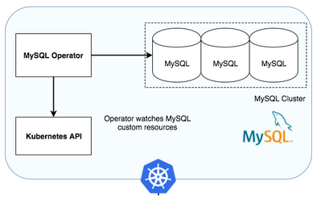
Running a MySQL Database in Containers - The Right Way
The MySQL Operator teaches Kubernetes what it needs to do to run MySQL the right way.
It teaches Kubernetes to treat MySQL clusters as a first-party resource type in Kubernetes’.
It teaches it how many nodes you need to have a minimally HA cluster in your Kubernetes environment.
It allows you to create and manage MySQL backups for your MySQL containers more easily.
It even teaches Kubernetes what to do if one of your MySQL database instances goes down; that is, to auto-heal by creating a new one and adding it in to the cluster
Notes:
This screen represents the features of an existing MySql Operator. What you can see is this Operator Teaches the Kubernetes Orchestration engine on how to handle various aspects of the MySql containers, things like, How to run MySql the right way, how to Treat MySql Clusters, how to manage MySql and what to do when an instance goes down.

Slide 53
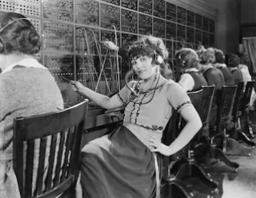


Operators Constantly Listen
What do all of these Operators have in common?
They sit and wait for someone to initiate a request
Notes:
If you think about the word Operator, what pictures come to mind. Depending on your age, there are 3 pictures that may come to mind. The first is the picture of a switchboard Operator who’s job it was to receive incoming calls and then forward them to their destination number.
A more modern picture is that of the call center agent. There job also is to wait for incoming requests and then respond to the caller.
And lastly, there is the Online assistant, who also waits for incoming inquiries so they can provide assistance.
What do all these types of Operators have in common??? The sit and wait for someone/something to initiate a request.

Slide 54
Characteristics of Openshift Operators
Openshift Operators, once installed, are provisioned as running POD’s in the Openshift architecture
As a running POD, their job is to wait for new requests. When a request is made the operator performs its actions.
- For example, provision a new MySql DB
Perform constant Health Checks on operators running in the Pod’s
Perform updates on the Pod’s
Notes:
The Openshift operators, once installed, are provisioned as running POD’s in the Openshift architecture
As a running POD, their job is to wait for new requests, and when a request is received the operator performs its actions
After provisioning the container, the Operator will perform constant health checks on the pods it created
Lastly, it can also perform updated on the POD’s

Slide 55

A broad ecosystem of workloads
Operator-backed services allow for a
SaaS experience on your own infrastructure
Relational DBs
Big Data
Monitoring
Security
NoSQL DBs
DevOps
AL/ML
Messaging
Storage
Notes:
The Operator backed services allow for a SaaS like experience on your infrastructure. There are Operators today that provide application configuration like seen in the picture above. For example, Monitoring, Security, DevOps and others.

Slide 56

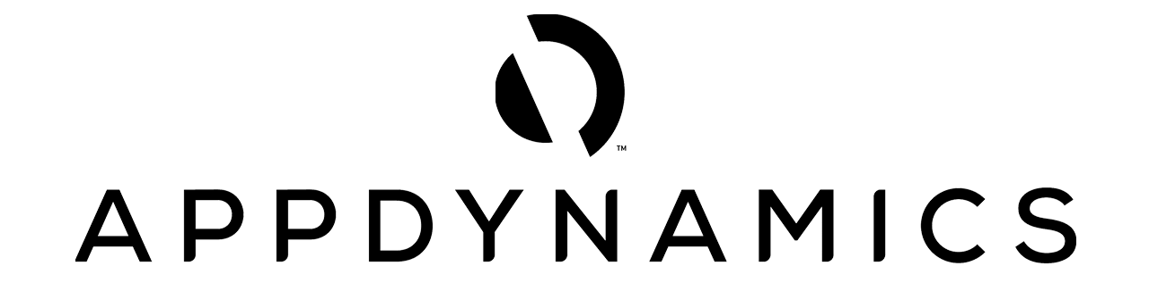



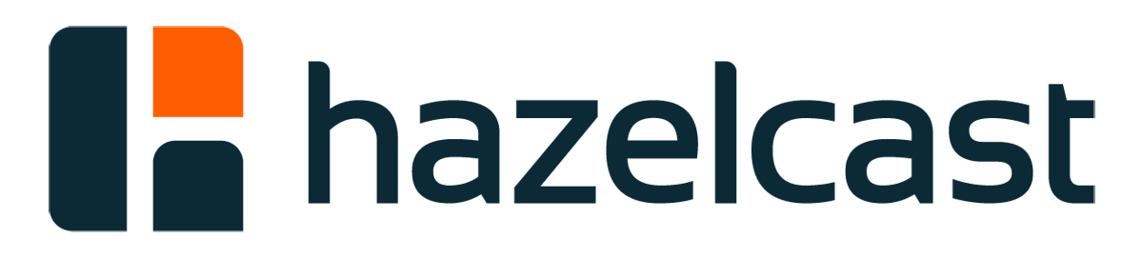



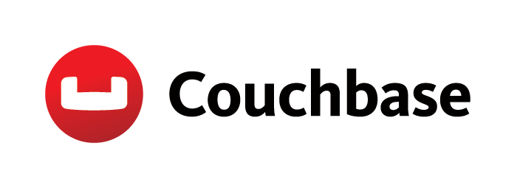











BROAD ECOSYSTEM OF WORKLOADS
Red Hat Certified Operators
DEVOPS
APM
DATA SERVICES
DATABASE
SECURITY
STORAGE
Notes:
Red Hat has its own list of Certified Operators

Slide 57
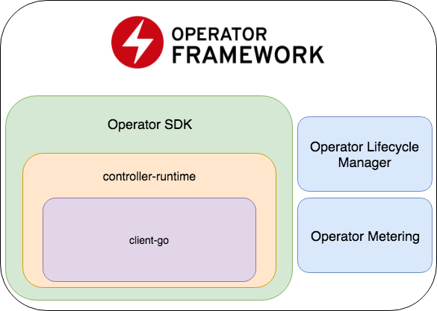
Notes:
In addition, Red Hat has created an Operator Framework that can be used to create new Operators.

Slide 58

OPERATOR SDK
SDK for building Kubernetes applications. Provides high level APIs, useful abstractions, and project scaffolding.
Tools to get started quickly embedding application business logic into an Operator.
Saves you from doing the dirty work to set up scaffolding
Help run end to end tests of your logic on a local or remote cluster
Used by Couchbase, MongoDB, Redis and more
Embed unique operational knowledge
Package and install
on Openshift Container Platform clusters
Notes:
The Operator Framework contains a Software Development Kit that can be used to get started quickly and build, package and install Kubernetes applications on the container platform clusters.
Using the Operator SDK saves you from doing the dirty work of having to setup and maintain your containerized applications
SDK code repo: https://github.com/coreos/operator-sdk
Intro blog post: https://coreos.com/blog/introducing-operator-framework
Demo from Summit: https://www.youtube.com/watch?v=WDr9TSyK9DA&feature=youtu.be&t=1620

Slide 59
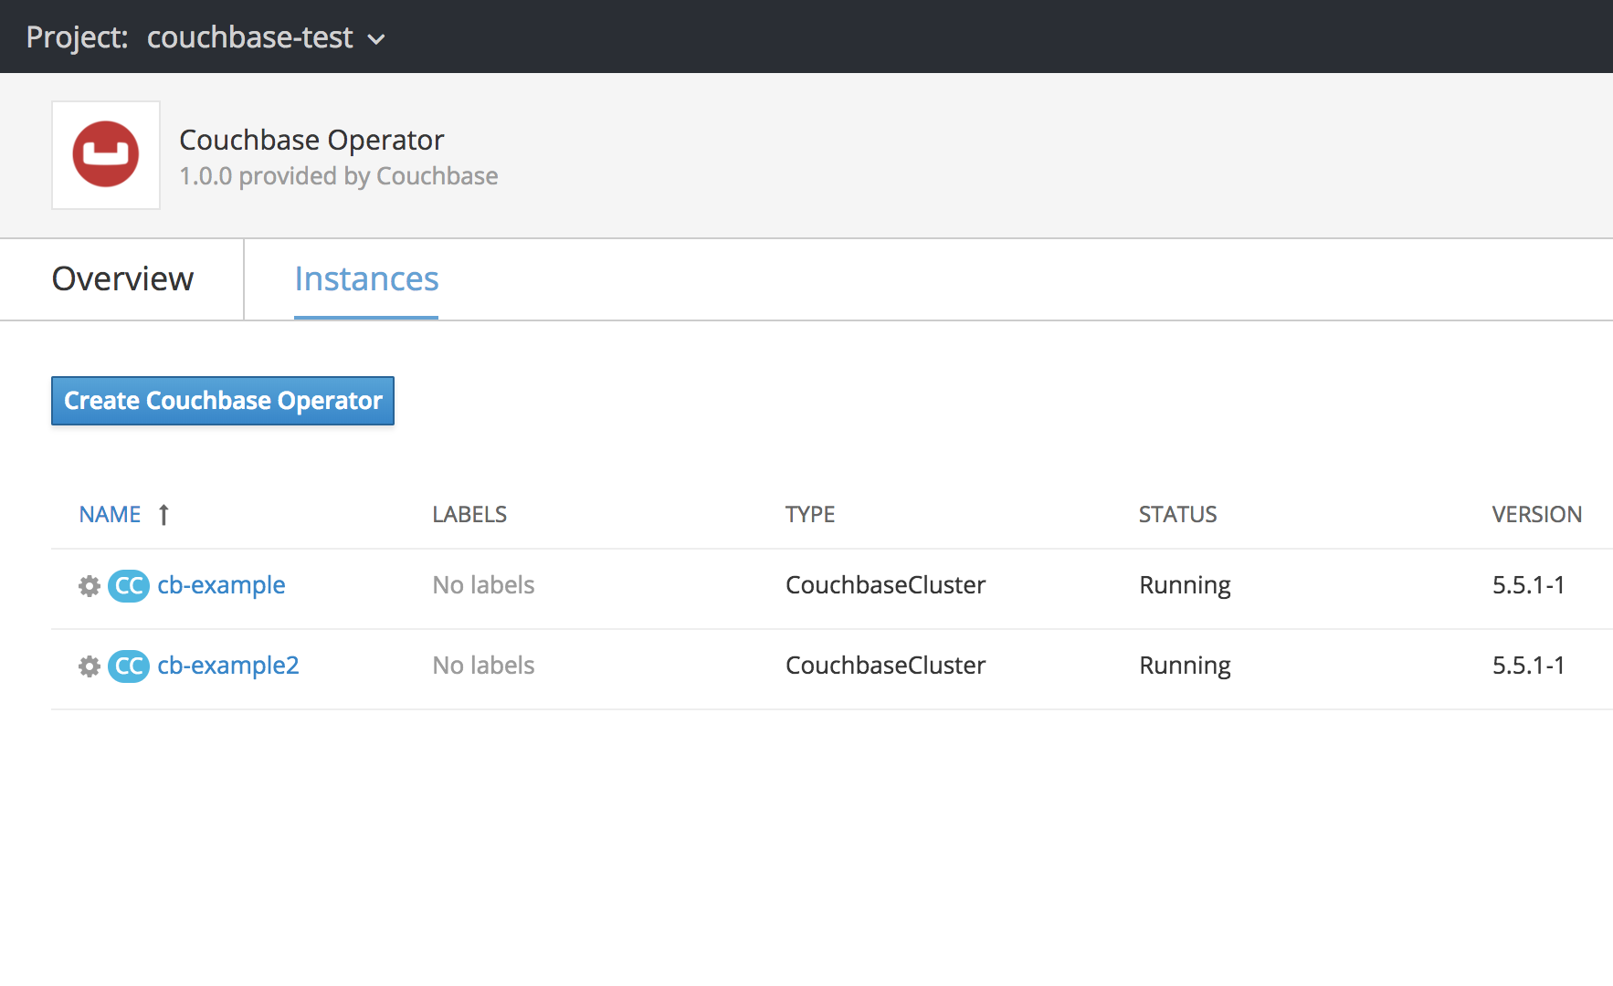
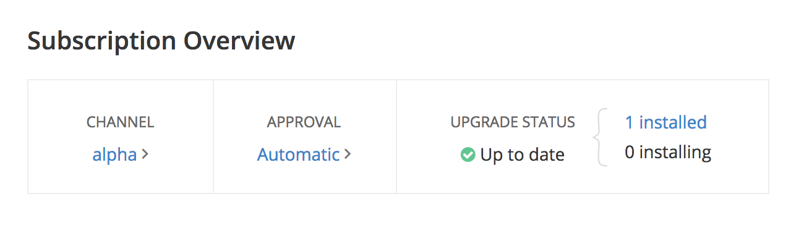
OPERATOR LIFECYCLE MANAGER
A management framework for extending Kubernetes with Operators
Run, manage and upgrade many Operators on top of the cluster
Catalog of curated Operators
Handles rolling updates of all Operators to new versions
Access control (RBAC) for certain teams to use certain Operators
Notes:
Another feature of the Operator Framework is the Operator Lifecycle Manager
The Lifecycle Manager is used to manage the framework used to extend Kubernetes.
Specifically, it is THE force behind managing Operators on the cluster. When an administrator uses an Operator on a project, it’s the lifecycle manager that watch’s the pods containing the applications, and is responsible for performing updates and access control of the container.

Slide 60

OPERATOR METERING
Operator metering is responsible for collecting metrics and other information about what's happening in a Kubernetes cluster, and providing a way to create reports on the collected data.
Notes:
Last but not least is Operator Metering. This feature is responsible for collecting metrics and other information about the Kubernetes Cluster, and provides that information back as a report to the Openshift console.

Slide 61
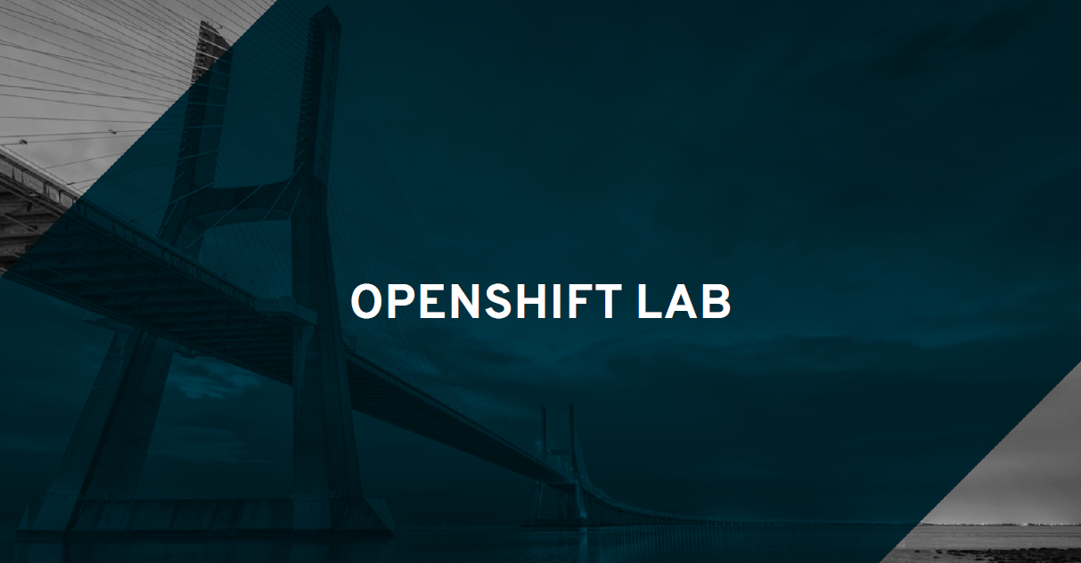

Slide 62
https://master.mobia-f9a4.open.redhat.com/console
Lab Material
https://github.com/jimgarrett123/openshift_workshop/
https://master.mobia-f9a4.open.redhat.com/console
OpenShift Console Login
https://master.mobia-f9a4.open.redhat.com/console
OC Login
oc login https://master.mobia-f9a4.open.redhat.com –u <user#>
Password: openshift

Slide 63
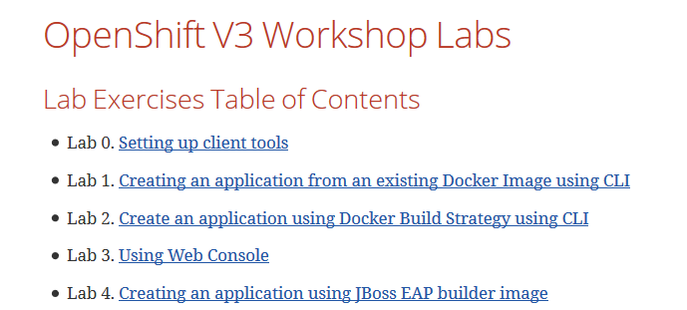
Setting up client tools
Notes:
The information previously conveyed in the Roadshow material may not be accurate.
If attendees have previously installed the Client Tools then they will need to remove the old tool and install the latest version.
The instructions convey how to do this

Slide 64
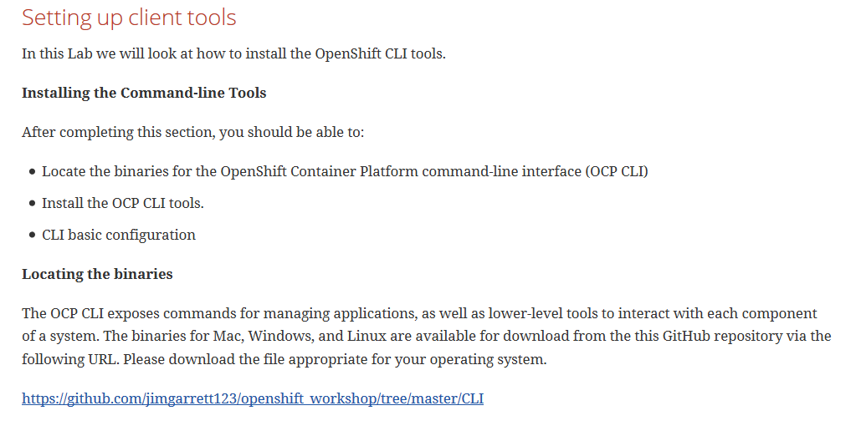
Notes:
Click on the Link to access the latest CLI tools used for this workshop.

Slide 65
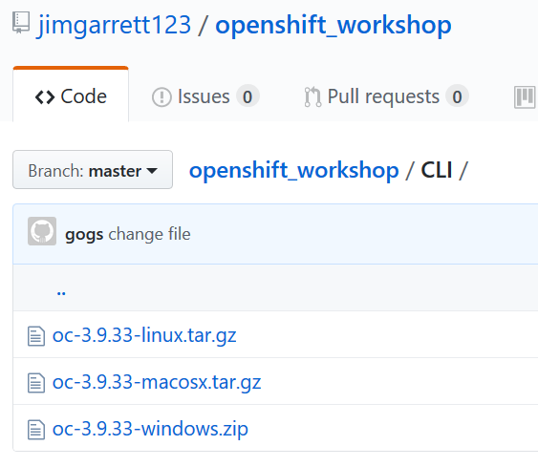

Slide 66
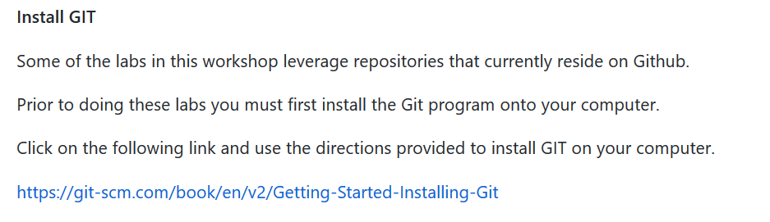

Slide 67
Lab 1: Create an App from a Docker Image
Step 1: Add a new project from the command line
$ oc new-project mycliproject-UserName --description="My CLI Project" --display-name="CLI Project“
Step 2: Create an application from a Docker Image
$ oc new-app redhatworkshops/welcome-php --name=welcome
*
*
*
Step 4: Try your application
Notes:
Step 1: creates a new project in your Openshift environment.
Step 2: creates an application from an existing Docker Image. The Image is pulled from the DockerHub.

Slide 68
Create Application
Create an application based on an image from Docker Hub (https://hub.docker.com) :
$ oc new-app redhatworkshops/welcome-php --name=welcome
Create an application based on an image from a private registry:
$ oc new-app --docker-image=myregistry.com/mycompany/myapp --name=myapp
Create an application based on source code stored in a Git repository:
$ oc new-app https://github.com/openshift/ruby-hello-world --name=ruby-hello
Notes:
There are multiple ways to create an application.
Examples include:
Create application based on image from Docker Hub
Create application based on image from private registry
Create application based on source code in repository

Slide 69
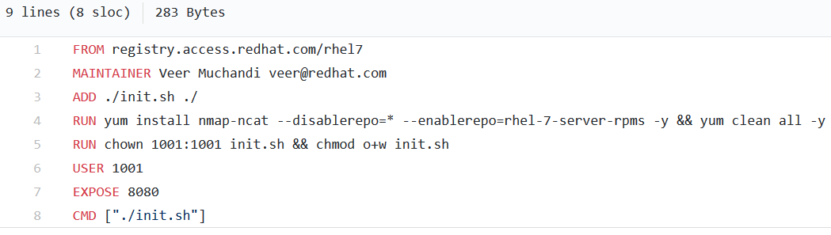
Lab 2: Create an App using Docker Build
Notes:
Applications can be added to Openshift by using an existing Dockerfile containing instructions on how to build the image.
In the Dockerfile above you can see where Docker pulls the initial image from “registry.access.redhat.com/rhel7”. This will create the base image containing the RHEL 7 operating system.
Line 3 shows where a file, init.sh, is added to the image
Line 4 enables a repository and adds several modules
.
.
Line 8 starts the image by processing he init.sh shell script

Slide 70
Lab 3: Using the Web Console
In this lab exercise, we will review the OpenShift Web Console.

Slide 71
Lab 4: Creating an application using JBoss EAP builder image
Learn how to create an application using source code and the JBoss EAP builder image.
The EAP builder image:
Found in a Github source code repository
Contains source code tree formatted to match JBoss EAP

Slide 72
Lab 5: Use a Template to provision a container
Out of the box Openshift contains a registry of existing container templates that can be use to provision new containers.
In this workshop you will use existing templates to provision a MySql database and a PHP application.

Slide 73
Lab 6: Scale Application Instances Up/Down
One of the features provided by Openshift is the ability to dynamically scale the number of container instances (in pods) up/down.
In this lab you will experiment with this feature.

Slide 74
Lab 7: Binary Deployment of a WAR file
In this exercise you will learn to deploy a war file. We will assume that you built your source code outside of OpenShift build process and want to download the WAR file on your workstation.

Slide 75
Lab 8: How to configure SSL
In this exercise you will set up your application to encrypt traffic with the OpenShift Wildcard certificate.

Slide 76
Lab 9: Blue Green Deployments
Blue-green deployment is a release strategy that can be utilized by developers for deploying software in a production environment. Blue can be one particular production environment whereas green can define an identical production environment. Under blue-green deployment strategy, software developers are able to minimize downtime and reduce risk.
In this Lab, we will be:
Deploying two versions of the same application.
The first version will display a blue rectangle.
The second version will displays a green rectangle.
We will then switch the FQDN from the first application (blue) to the second application (green).

Slide 77
Lab 10: SCM Web Hooks
What is a WEB HOOK?
A Webhook is a lightweight configurable tool, that allows you to easily create HTTP endpoints (hooks) on your server, which you can use to execute configured commands when changes in source code are detected.
Provides mechanism to initiate CI/CD when source code changes.

Slide 78
Lab 11: Rollback Applications
In this lab we will see how we can rollback an application in OpenShift quickly without switching to an older version of the source code in SCM.
Why is this important? What function does this provide?

Slide 79
Lab 12: Code Promotion Across Environments
In this lab we will learn how an application image binary can be promoted across the environments.
As an example we will use development and QA environments.

Slide 80
Lab 13: Changing Code on the Fly
In this lab, we will learn how to make changes to the code on the local machine and immediately sync it with the code running in a pod.
This lab is analogous to what a developer would encounter when developing and changing his code that is then deployed to a container.

Slide 81
Lab 14: Creating a Pipeline
What is a BUILD PIPELINE?
A Build Pipeline is a process for getting software from version control into the hands of your users.
That process involves building the software, followed by the progress of the build through multiple stages of testing and deployment.
The build pipeline allows you to see the progress of each change as it moves from version control through various sets of tests and deployments to release to users.

Slide 82
Lab 15:Using .NET and PostgreSQL Template
In this lab exercise we will learn how to use OpenShift Web Console to spin up a PostgreSQL database and .Net application using templates.

Slide 83
THANK YOU
plus.google.com/+RedHat
facebook.com/redhatinc
linkedin.com/company/red-hat
twitter.com/RedHatNews
youtube.com/user/RedHatVideos

